Slide 1
Global System For Mobile Communication (GSM)

Slide 2
Introduction
Global system for mobile communication (GSM) is a globally accepted standard for digital cellular communication.
GSM is the name of a standardization group established in 1982 to create a common European mobile telephone standard that would formulate specifications for a pan-European mobile cellular radio system operating at 900 MHz.
GSM provides recommendations, not requirements.
The GSM specifications define the functions and interface requirements in detail but do not address the hardware.
GSM system covers approximately 70% of market share.

Slide 3
Characteristics
Fully digital system utilizing the 900 MHz frequency band.
TDMA over radio carries (200kHz carrier spacing).
User/terminal authentication for fraud control.
8 full rate or 16 half rate TDMA channels per carrier.
Encryption of speech and data transmission over the radio path.
Full international roaming capability.
Low speed data services (up to 9.6 kbps).
Compatible with ISDN.

Slide 4
GSM Networks
GSM networks presently operate in the following frequency ranges:
GSM 900 operates in the 900 MHz frequency range and is the most common in Europe and the world.
GSM 1900 (also called PCS-1900, or DCS-1900), the only frequency used in North America for GSM.
GSM 1800 (also called PCS-1800 or DCS-1800) operates in the 1800 MHz frequency range, and is found in a rapidly increasing number of countries, including France, Germany, Switzerland, UK and Russia.

Slide 5
Abbreviations
MS – Mobile Station
MT – Mobile Terminal
TE - Terminal
PLMN – Public Land Mobile Network
ISDN – Integrated services digital network
PSTN – Public Switched Telephone Network
MSC –Mobile Service Switching Center
U, S, R – Interface, S = Data transmission R = translation, U = Basic Rate interface (BRI)

Slide 6
Mobile Services
GSM permits the integration of different voice and data services and the interworking with existing networks
GSM has defined three different categories of services:
Bearer Services
Tele Services
Supplementary Services

Slide 7
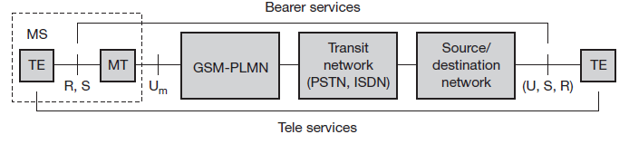
Mobile Services
A MS is connected to the GSM-PLMN via U_{m}
This network is connected to transit network
Before connecting to TE additional source/destination may be there
Within the MS, MT performs all network specific tasks and offer interface for S to TE
Depending on capability of TE, further interface R may be needed
Bearer and tele services reference model

Slide 8
Bearer Services
Bearer services permit transparent and non-transparent, synchronous or asynchronous data transmission.
Transparent bearer services only use the functions of the physical layer to transmit data.
Transparent bearer services do not try to recover lost data.
Non-transparent bearer services use protocols of layers two and three to implement error correction and flow control.
GSM also specifies several bearer services for interworking with PSTN, ISDN and packet switched public data networks (PSPDN).
Data transmission can be full-duplex, synchronous with data rates of 7.2,2.4, 4.8 and 9.6 kbit/sec, asynchronous from 300 to 9600 bit/sec.

Slide 9
Tele Services
GSM mainly focuses on voice-oriented tele services.
These services include encrypted voice transmission, message services and data communication with terminals
It provides high quality digital voice transmission of 3.1 kHz of analog phone systems.
Special codecs are used for voice transmission
Another service offered by GSM is the emergency number, i.e., same number can be used throughout Europe.
This service is mandatory for all providers and free of charge.

Slide 10
Tele Services
Another useful service of GSM is short message service (SMS).
This service offers transmission of message of up to 160 characters.
SMS messages do not use the standard data channels of GSM but exploit unused capacity in the signaling channels.
EMS enhanced message service, successor of SMS offers a large message size, formatted text and the transmission of animated pictures, small images and ring tones
MMS offers the transmission of larger pictures, small video clips
In Group 3 fax, fax data can be transmitted as digital data over analog signals

Slide 11
Supplementary Services
Supplementary services offer various enhancements for the standard telephony services.
It may vary from provider to provider.
Typical services are user identification, call redirection or forwarding of ongoing calls.

Slide 12
GSM Architecture

Slide 13
Abbreviations
RSS – Radio Sub System
NSS – Network and Switching sub-system
OSS - Operation Sub-Systems
BSS - Base Station Sub-system
BTS - Base Transceiver Station
BSC - Base Station Controller
PIN - Personal Identity Number
PUK - PIN Unblocking Key
IMSI - International Mobile Subscriber Identity
TMSI - Temporary Mobile Subscriber Identity

Slide 14
LAI - Local Area Identity
MSISDN - Mobile Stations International Standard Data Network
HLR - Home Location Register
VLR - Visitor Location Register
AUC - Authentication Center
EIR - Equipment Identity Register
OMC - Operations and Maintenance Center
IWF – Inter Working Function
GMSC- Gateway MSC

Slide 15
GSM Architectures 3 broad parts
1. Subscribers carries MOBILE STATION
2. BSS controls the radio link with the mobile station
3. NETWORK SUBSYSTEM, which main part is MSC

Slide 16
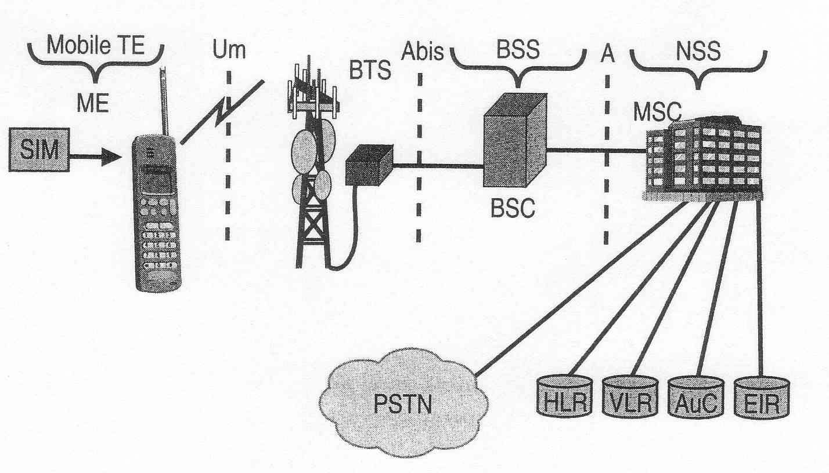
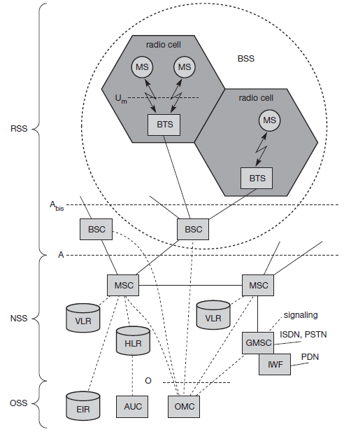
Functional architecture of a GSM system

Slide 17
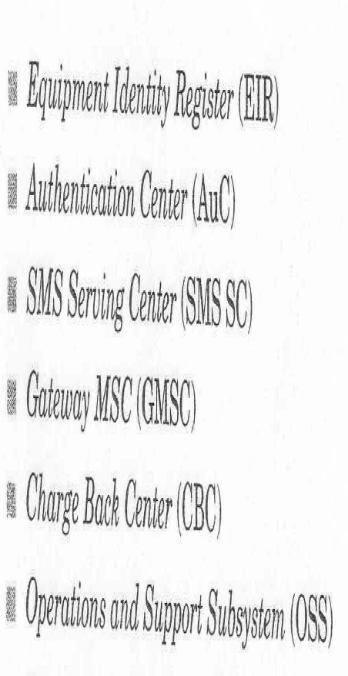

Slide 18
Home Location Register (HLR) contains all information of each subscriber registered in the corresponding GSM network
Visitor location Register (VLR) contain selected information from the HLR, which is necessary for call control and provision of the subscribed services.

Slide 19
Equipment Identity Register (EIR) contains a list of all valid mobile equipment on the network
Authentication Center (AUC) stores a copy of the secret key stored in each subscribers SIM card

Slide 20
GSM Architecture
GSM network are structured as a hierarchical, complex system architecture comprising many entities, interfaces, and acronyms.
A GSM system consists of three sub-systems:
The radio sub-systems (RSS)
The network and switching sub-systems (NSS)
The operation sub-systems (OSS).

Slide 21
RSS
The RSS contains all radio specific entities, i.e., the mobile station (MS) and the base station sub-system (BSS).
The RSS is connected to NSS by the 'A' interface and OSS by 'O' interface.
RSS basically contains three entities :
BSS
BTS
BSC

Slide 22
Mobile Station
MS = ME + SIM
The SIM card contains following identifiers and tables
PIN
PUK
IMSI
TMSI
LAI
MSISDN

Slide 23
NSS
NSS contains following switches and database
MSC
HLR VLR

Slide 24
OSS
OSS contains following entities
AUC
EIR
OMC

